Slide 1
UEN002 – Energy and Environment
Solid Waste Pollution and Management – SWM
This chapter involves a series of lectures that constituting Introduction, SWM management scenario in India and abroad, Management Strategies including recycling, and MSW’s association with Clean Development Mechanism….
In this session….
We will be focusing on the fundamental aspects related to SWM and other wastes.

Slide 2
Solid waste, Pollution and Management
SWM-1

Slide 3
Solid Waste - Definition
Solid material possessing a negative economic value – it is cheaper to discard than to use.
(or)
Includes Garbage, refuse, sludges and other discard sold materials resulting from industrial and commerical operations and from community activities
Does not include solids of dissolved materials in domestic sewage or other significant pollutants in water resources, such as silt, dissolved or suspended solids in industrial wastewater effluents, dissolved materails in irrigation return flows or other common water pollution

Slide 4
Sources of solid waste
Residential
Commercial
Institutional
Construction and demolition
Municipal services
Treatment plant sites
Industrial
Agricultural
Biomedical waste
Municipal solid waste (MSW)
Industrial solid waste
Agricultural waste
Hospital waste

Slide 5
Municipal Solid Waste
MSW – Domestic waste or household waste generated within a community from several sources
MSW Generation as a function of source
  Residential
    Single and multi-family homes
  Commercial
    Office buildings, retail companies, restaurants, hotels
  Institutional
    Schools, Hospitals, Hostels
  Industrial
    Packaging and administrative; but not process wastes
  Municipal

Slide 6
Major discards in municipal solid waste
Paper
Plastics
Rubble and dust
Glass
Metals
Biodegradable organics
Hazardous organics

Slide 7
Catagories of municipal solid waste
Combustible, compostable and recyclable
  Newspaper, cardboard
Recyclable and combustible (not compostible)
  PET bottles, HDPE, polyurethane, plastic bags, rubber pads
Recyclable (not combustible and compostable)
  Aluminium bevarage cans, food containers
Compostible and combustible (not recyclable)
  Food waste and yard waste
Combustible (not recyclable and compostable)
  Wood, textiles, rubber, leather, thermocole
Not Combustible/compostable/recyclable
  Hard aluminium, construction material, batteries, synthetic organics

Slide 8
Nature of Industrial solid waste
Hazardous and Non-hazardous waste
Characteristics - Hazardous
  Corrosivity
  Flammability
  reactivity
  Toxicity
Catagories
  Chemicals
  Biological
  Radioactive
  Explosives

Slide 9
Functional elements of SWM
Generation
Storage
Collection
Transportation
Processing and Recovery
Disposal

Slide 10
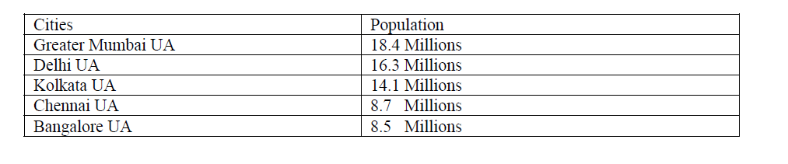
SW Management elements
Generation/storage
Netherlands 16.7 million

Slide 11
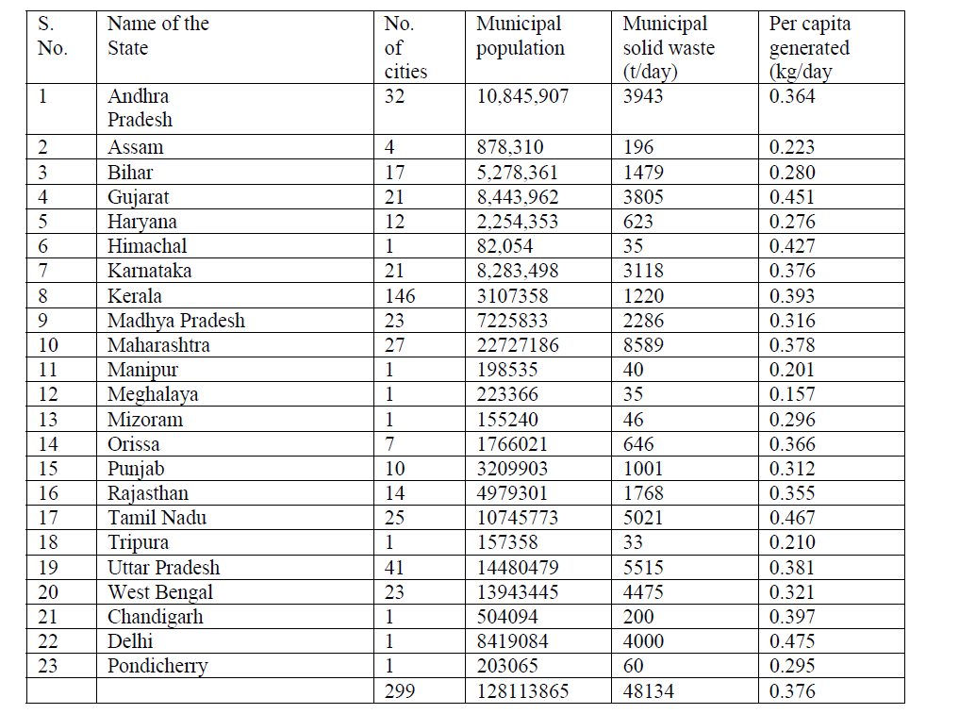
SW Management elements
Generation/storage

Slide 12
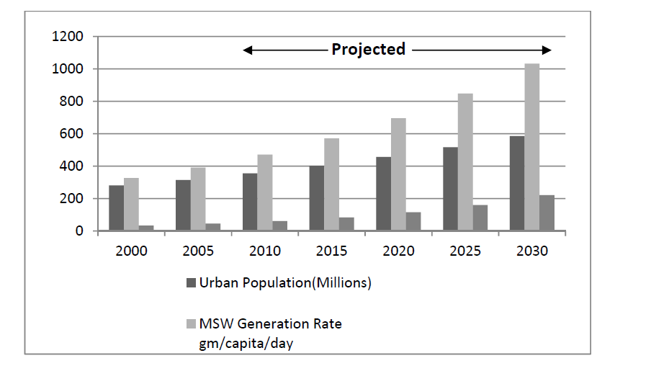
SW Management elements
Generation/storage

Slide 13
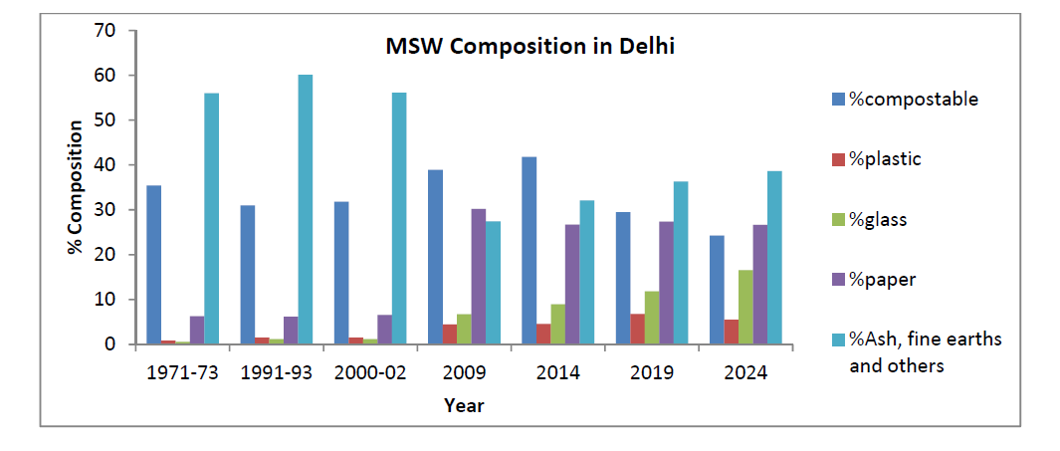
SW Management elements
Generation/storage

Slide 14
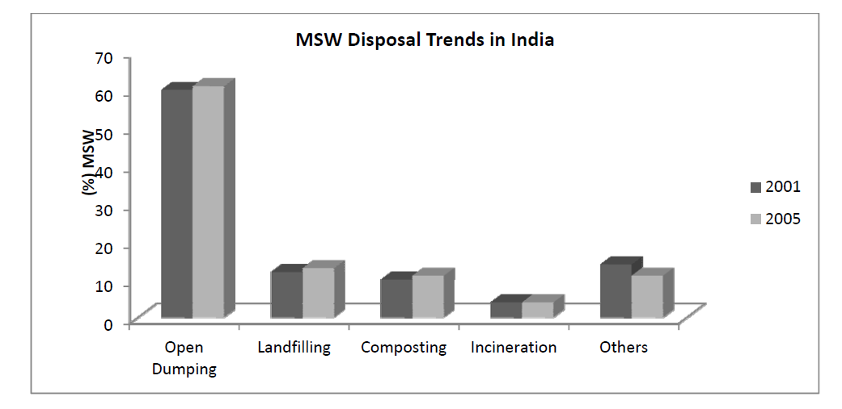
SW Management elements
Generation/storage

Slide 15
SW Management elements
Generation/storage
Per capita - 500 gm in small towns; 1.5kg in large towns
Mumbai - 1991 - 5355 tonnes per day
- 2001 - 6500 tonnes per day
Average collection efficiency of Indian cities – 72%
Cities lacking adequate waste transport facilities – 70%
Future scenario - 260 million tonnes by 2047
- land filling space required – 1400 sq.km
- CH₄ generation – 29 million tonnes - 2047

Slide 16
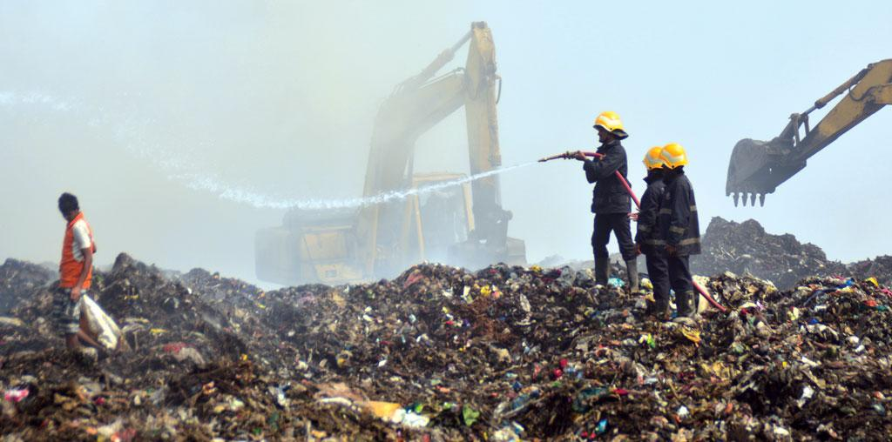
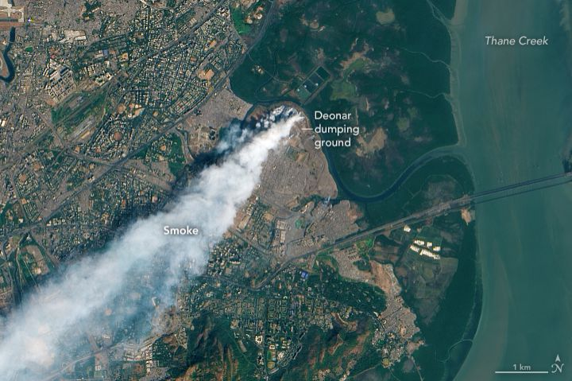
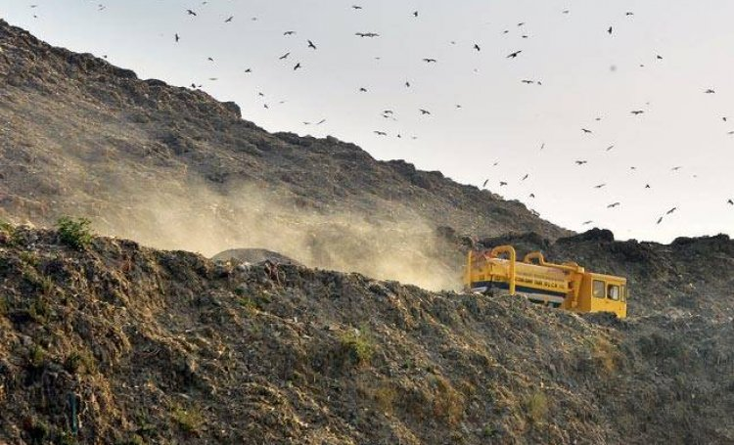
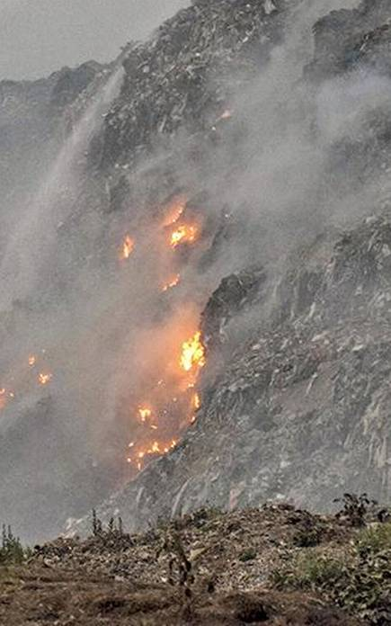

Slide 17
SW Management elements
Collection and transportation
Major budgetary expenditure of Municipal operations
Emerging management strategies
  Contracting of maintenance, equipment and vehicle fleet
  Service contracts for waste collection and transportation
  Long term concession projects for resource recovery
    Waste composting projects
    Waste to Energy (WTE) projects
  Community contracting

Slide 18
Properties of solid waste
Transformation processes
  Physical – seperation, volume reduction, size reduction
  Chemical – combustion, pyrolysis, gasification
  Biological – composting (aerobic/anaerobic)
Importance of transformation
  Improve efficiency of SWM systems
  Recover reusable and recyclable materials
  To recover conversion products and energy

Slide 19
In the next session….
We will be draw our attention towards the quantification, characterization of solid waste and its association with management strategies.

